Slide 1


Data Journalism:
Introduction
@PaulBradshaw
#bcujournos

Slide 2
A broad range of tools, techniques and concepts
Spreadsheets
Computational thinking
Critical cartography
Coding
Cleaning
Mobile-first design
HTML, CSS & JavaScript
SQL, ChatGPT and other tools

Slide 3
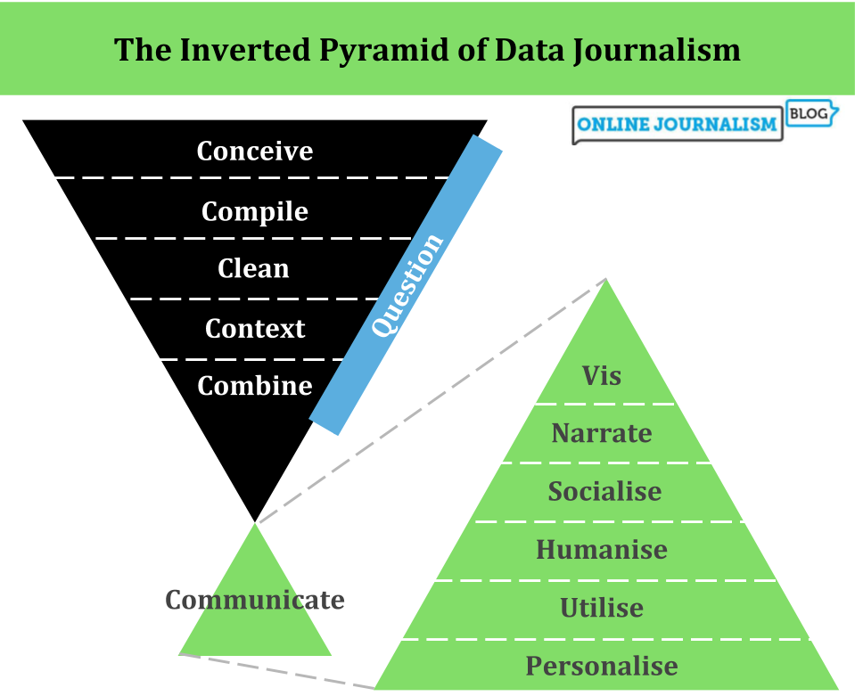

Slide 4
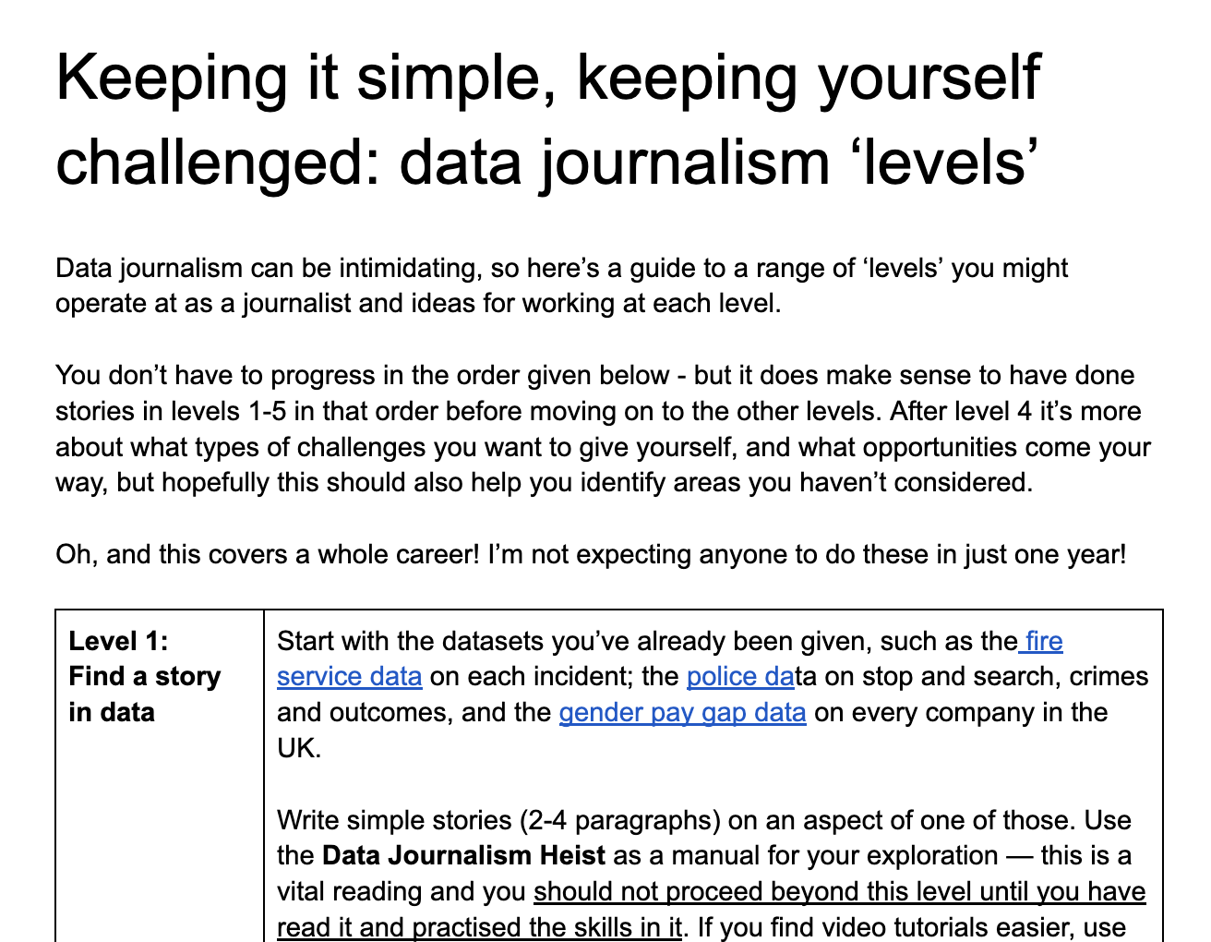
https://docs.google.com/document/d/1FMpBaCk1Cg5-n111STb1nUUPQgAfc2mXhXL-qZlDhGc/edit?usp=sharing

Slide 5
Those levels:
Find a story in data (2-4 pars)
Add visualisation
Plan a diary story
Prepare to write a story for scheduled data release
Add quotes
Respond to a news event
Plan a data-driven feature/investigation
Source exclusive data
Use coding
All of the above

Slide 6
Data Journalism:
Assessment
@PaulBradshaw
#bcujournos

Slide 7
Key points:
Assessment criteria
What can I do?
The evaluation

Slide 8
2 criteria (learning outcomes)
Identify, gather and communicate stories based on structured information using data journalism techniques and technologies for an identified audience
Critically evaluate the professional, legal and ethical contexts surrounding data journalism and apply that to a specific project

Slide 9
Let’s break
that down.

Slide 10
Criteria 1:
Identify: Generate lots of story ideas — and then develop and improve them with feedback
Gather: Source data in different ways
Communicate: Draft and re-draft; use datavis; review and improve; spellcheck!
Data journalism techniques: Excel is fine. Vis is another. You can use code if you want.
An identified audience: have an idea who you’re writing for

Slide 11
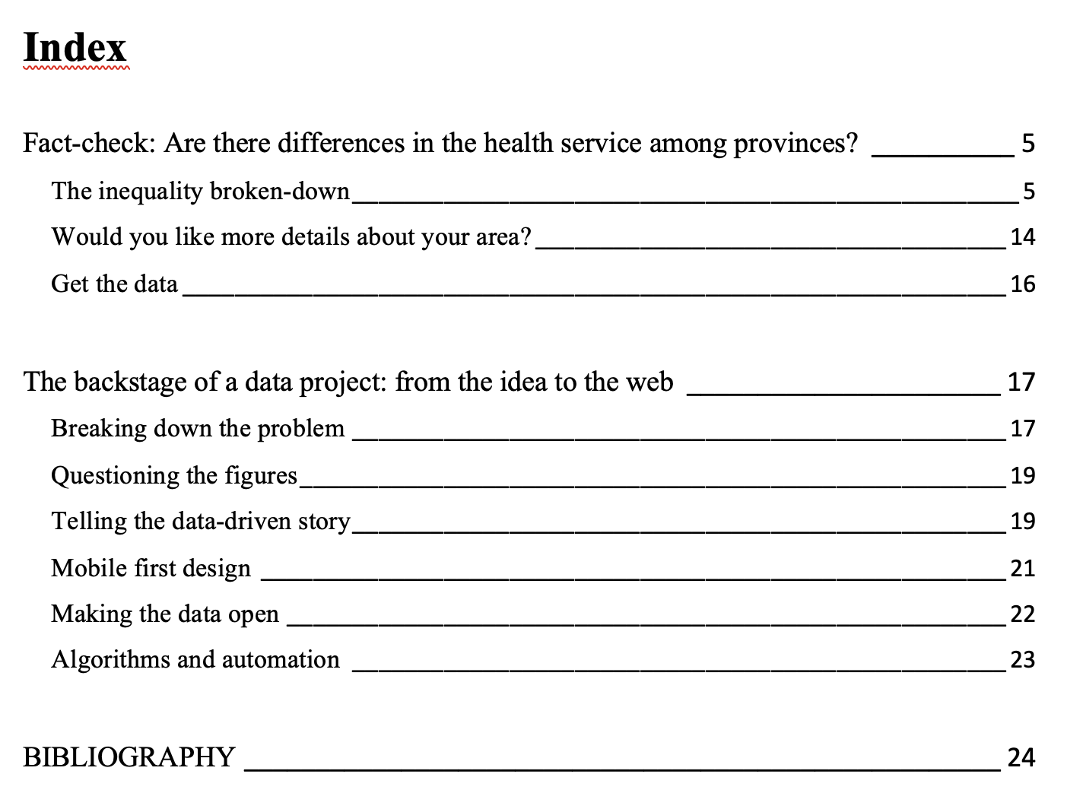
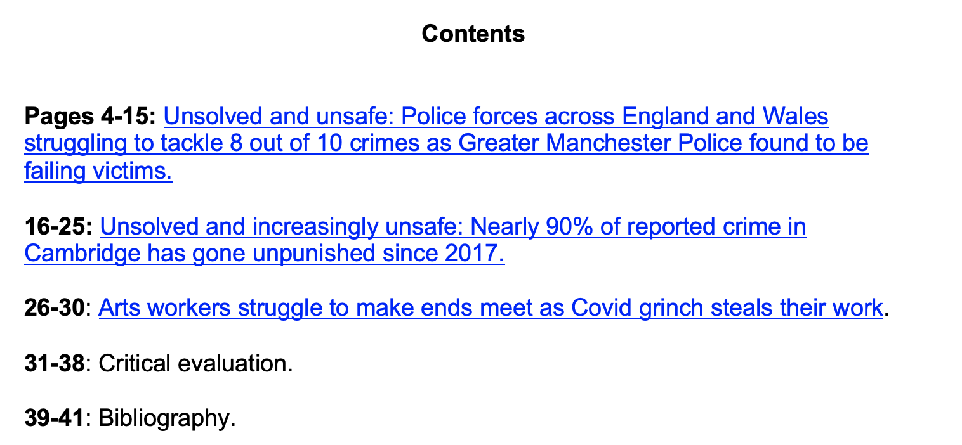

Slide 12
Portfolio element(s)
A few shorter pieces (recommended), or one longer story (if you’ve already done data-driven news stories as a journalist)
Consider:
Interviews
Visualisation/interactivity
Social updates
Audio/video (e.g. two-ways, animated video etc)

Slide 13
Identify, gather and communicate stories based on structured information using data journalism techniques and technologies for an identified audience:
Criterion 1 (weighting 60%):
Quality of newsgathering and processing/analysis: use of planning devices such as news diary, contacts book etc; use of techniques such as FOI/scraping/APIs, cleaning, use and breadth of interviews, quality of analysis, rigour & statistical validity of conclusions
Effective use of data journalism as a medium; strength of story ideas: clarity and accuracy of material (including any visualisation), spelling/grammar, structure, understanding of genre (e.g. feature vs news). Topicality of ideas, originality, and suitability for a particular audience and outlet.
CRITERION | 0-29% Fail | 30-39% Fail | 49-40 Borderline Fail | 50-59 Pass | 60-69 Merit | 70-79 Distinction | 80-100 Distinction
Newsgathering, processing, and analysis including digital skills | Information collected is not appropriate and has not been collected and processed/analysed systematically. | Information gathered is appropriate to some extent but necessary data is missing. Inappropriate use of processing/analysis tools. | Selects some appropriate information, and processes/analyses some of it adequately but with limited impact overall. | Adequate use of initiative to seek out sources of information and new insights. Effective evaluation of their validity against existing information to add to knowledge or understanding. | Very good use of initiative to seek out varied sources of information and new insights. Very effective evaluation of their validity against existing information to add to target audience’s current knowledge. | Excellent use of initiative to seek out original sources of information and new insights. Very effective evaluation of their validity against existing information to add to current knowledge. | Outstanding use of initiative to seek out original sources of information and new insights. Highly effective evaluation of their validity against existing information to add to current knowledge.

Slide 14
Identify, gather and communicate stories based on structured information using data journalism techniques and technologies for an identified audience:
Criterion 1 (weighting 60%):
Quality of newsgathering and processing/analysis: use of planning devices such as news diary, contacts book etc; use of techniques such as FOI/scraping/APIs, cleaning, use and breadth of interviews, quality of analysis, rigour & statistical validity of conclusions
Effective use of data journalism as a medium; strength of story ideas: clarity and accuracy of material (including any visualisation), spelling/grammar, structure, understanding of genre (e.g. feature vs news). Topicality of ideas, originality, and suitability for a particular audience and outlet.
CRITERION | 0-29% Fail | 30-39% Fail | 49-40 Borderline Fail | 50-59 Pass | 60-69 Merit | 70-79 Distinction | 80-100 Distinction
Effective use of data journalism as a medium/ strength of story ideas | This piece of work does not show evidence of creativity or innovation. Developed skills and techniques are not demonstrated here. | This work contains undeveloped ideas and/or little creativity or skill/technique. Minimal journalistic style and little insight into effective working processes are demonstrated here. | Work shows a basic level of technique. Journalistic style is lacking, with little understanding demonstrated of genre. Ideas need further development in terms of topicality and originality. | Work shows imagination and technique. Processes involved have creative application and outcomes but may lack clarity. Journalistic style is evident in work which shows some original application and adaptation of models. | Work shows well-developed imagination and technique. Processes involved are manipulated to achieve creative results. Builds on models and moulds influences with originality and distinctive personal style. | Creative work shows highly developed technique in the service of strong ideas and news sense. Processes involved are handled with assurance to achieve innovative results. Journalistic style consistently marked in work which builds on models with originality, flair and style. Potential for publication and dissemination. | Demonstrates striking innovation and creative imagination in work that reaches near-professional levels in its application of creative methods and techniques, resulting in material which is consummately well-crafted. High potential for publication and dissemination.

Slide 15
Criteria 2:
Critically: don’t just say what you did well
Evaluate: don’t just describe
Professional: what’s good practice in the field? Refer to literature.
Legal: what laws need to be considered?
Ethical: and ethics? Refer to literature.
And apply that to a specific project: how did you consider those - or should you have?

Slide 16
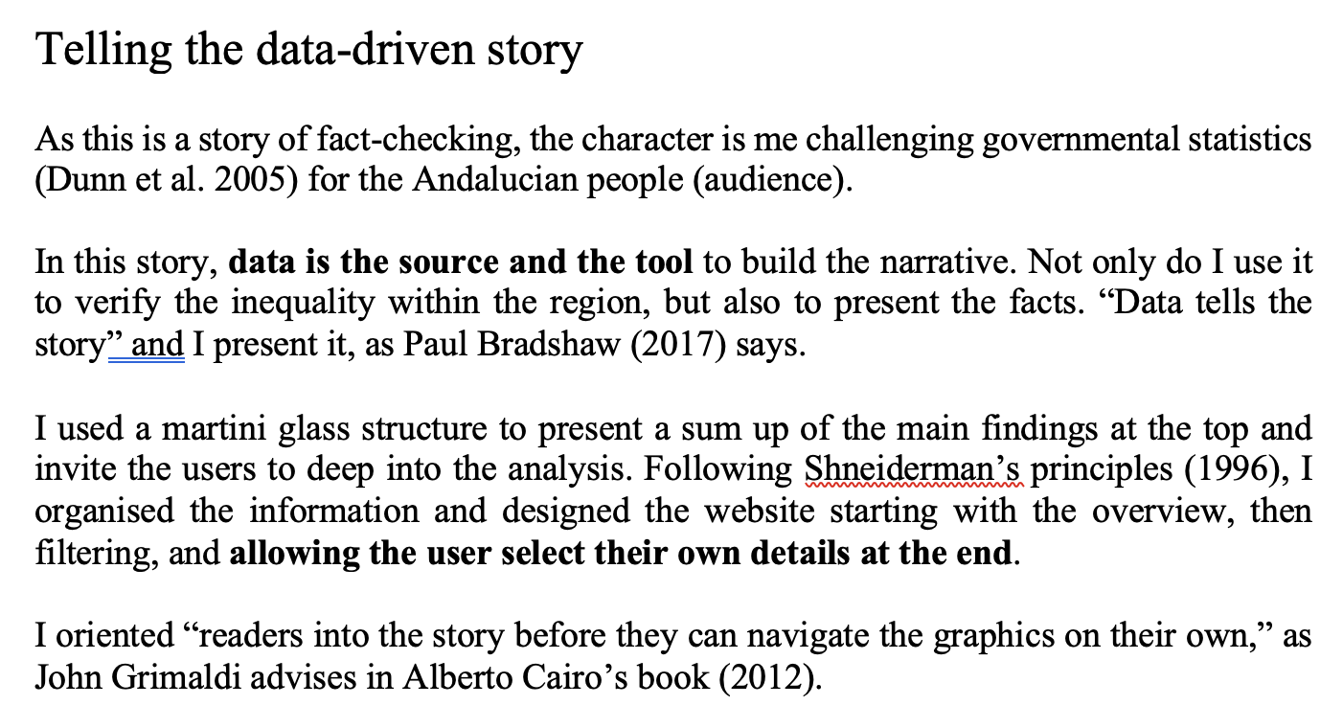
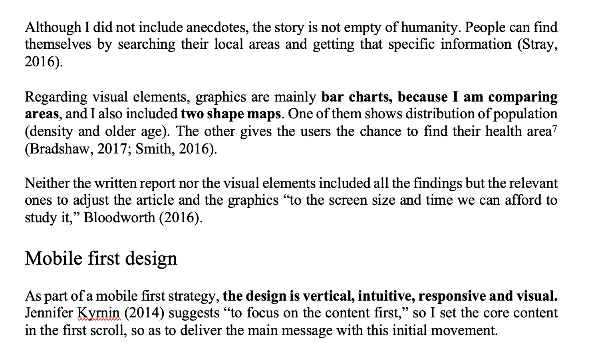

Slide 17
Issues covered in readings:
News values
Computational thinking
Literate programming (notebooks)
Critical issues in mapping
Best practice in vis, data cleaning, big data, FOI, etc.
Statistical literacy (Tim Harford)

Slide 18
What you should add to your CV now:
You learned to generate a range of ideas for stories using data. You are able to use spreadsheet techniques to find stories in data, and visualisation techniques to communicate them. You learned about mobile-first design and mapping. You (might) have a basic knowledge of R and coding techniques for finding stories.

Slide 19
Critically evaluate the professional, legal and ethical contexts surrounding data journalism and apply that to a specific project:
Use of literature/evidence of reading: exploration and critical application of literature on best practice in the field
Understanding of professional contexts including equality, diversity and inclusion (EDI): professional documentation, including research and ideas development. Exploration of relevant legal considerations (such as privacy, the use of FOI laws, defamation, contempt, copyright, etc.); exploration of relevant ethical considerations (such as accuracy, transparency, accessibility, inclusion, appropriate use of language, etc.)
CRITERION | 0-29% Fail | 30-39% Fail | 49-40 Borderline Fail | 50-59 Pass | 60-69 Merit | 70-79 Distinction | 80-100 Distinction
Use of literature/ evidence of reading | Little or no evidence of engagement with relevant literature. | Very limited evidence of independent reading. Core texts and/or some inappropriate sources may be referred to briefly and without critical analysis. | Limited evidence of broad and independent reading. Application of literature is descriptive rather than critical overall. | Evidence of independent reading from a wide range of appropriate sources, including current ones. Clear, accurate, systematic application of material. | Demonstrates broad and/or in-depth independent reading from appropriate sources, including the most current ones in the field. Choice of sources clearly enhances fulfilment of the assignment objectives. Shows an ability to appraise material critically. | Demonstrates very broad and/or in-depth independent reading from appropriate sources, including the most current ones in the field. Choice of sources clearly enhances fulfilment of the assignment objectives. Clear, accurate, systematic application of material with well-developed and/or integrated critical appraisal. | Demonstrates outstandingly broad and/or in-depth independent reading from appropriate sources, including the most current ones in the field. Choice of sources highly enhances fulfilment of the assignment objectives. Clear, accurate, systematic application of material with highly developed and/or integrated critical appraisal.

Slide 20
Critically evaluate the professional, legal and ethical contexts surrounding data journalism and apply that to a specific project:
Use of literature/evidence of reading: exploration and critical application of literature on best practice in the field
Understanding of professional contexts including equality, diversity and inclusion (EDI): professional documentation, including research and ideas development. Exploration of relevant legal considerations (such as privacy, the use of FOI laws, defamation, contempt, copyright, etc.); exploration of relevant ethical considerations (such as accuracy, transparency, accessibility, inclusion, appropriate use of language, etc.)
CRITERION | 0-29% Fail | 30-39% Fail | 49-40 Borderline Fail | 50-59 Pass | 60-69 Merit | 70-79 Distinction | 80-100 Distinction
Understanding of professional contexts including equality, diversity and inclusion (EDI) | Fails to work within the prescribed professional values. No consideration of, or reference to, diversity issues throughout. | Limited use of professional values and/or code of conduct frameworks. Very little consideration of, or reference to, diversity related issues and/or assumptions around diversity throughout. | Work is consistent with professional values but limited consideration of appropriateness and practicability. Some, but limited understanding of, or reference to, diversity related issues and/or assumptions around diversity throughout. | Good implementation of professional values such as objectivity and accuracy. Good understanding of, and reference to, diversity related issues and/or assumptions around diversity which are reasonably integrated throughout. | Very good implementation of professional values such as objectivity, accuracy, privacy, and transparency. Very good understanding of, and reference to, diversity related issues and/or assumptions around diversity embedded throughout. | Excellent implementation of all relevant professional contexts including objectivity, accuracy, privacy, and transparency. Excellent understanding of, and reference to, diversity related issues and/or assumptions around diversity embedded throughout including accessibility, appropriate use of language etc. | Outstanding implementation of professional values. Highly sophisticated understanding and consideration of diversity related issues and/or assumptions around diversity embedded throughout.

Slide 21
Include:
A copy of your stories (not just links)
Evaluation (that refers to…)
Bibliography (of sources referred to)
Appendices (evidence you refer to, e.g. planning, diary, contacts book, brainstorming, correspondence, drafts, analysis of examples, FOI requests)

Slide 22
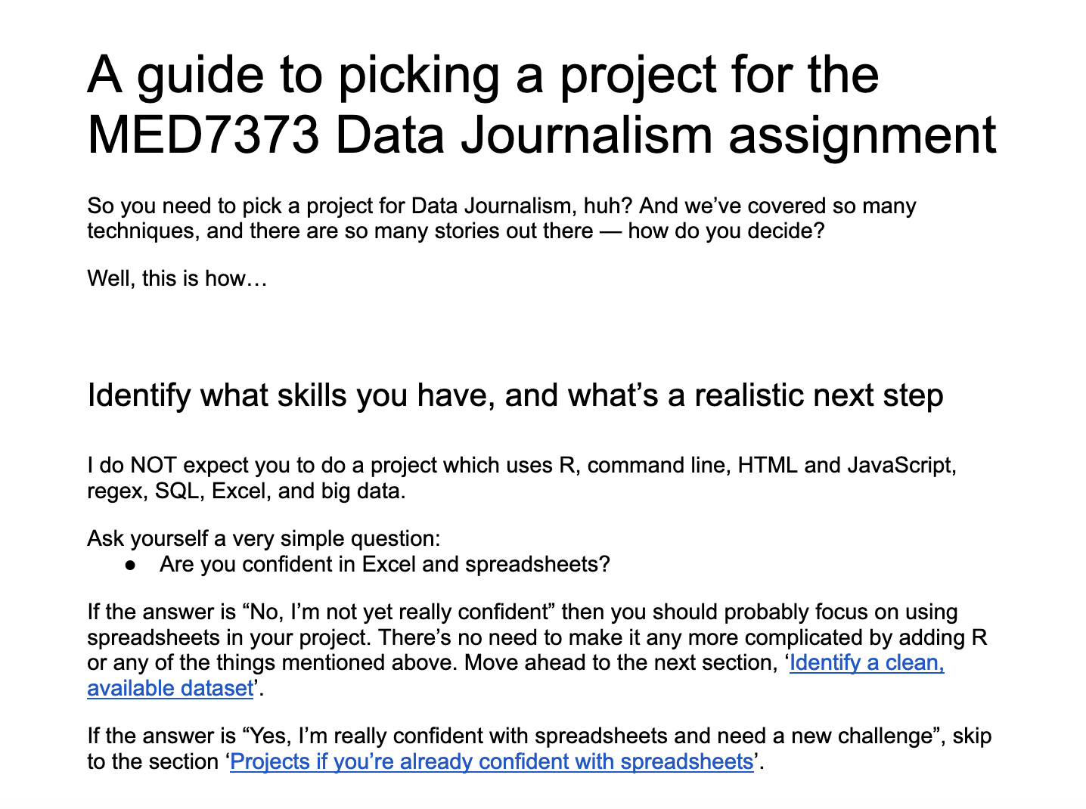
https://docs.google.com/document/d/e/2PACX-1vQEQOkk1WYLhyLUa0p491arBRTwXk7Vf6bD7cc3oD6ZDCyKE_kH2XVPJ8yLRL3p2QBdaQ_UeBEJCkQl/pub

Slide 23
Reading:
Read lots of data journalism for inspiration
See the readings in Moodle
Read more widely for issues specific to your practice and interests

Slide 24
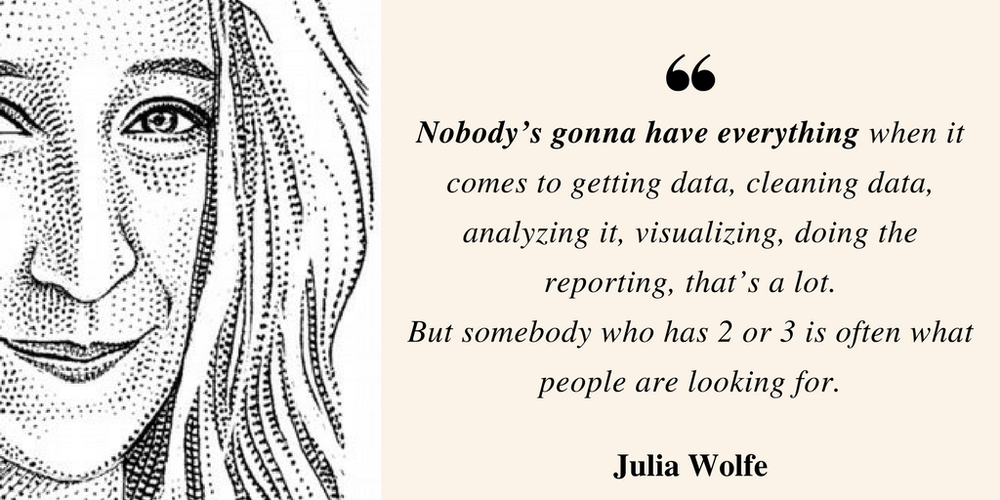
Julia Wolfe, WSJ, quoted in Cairo (2017) Nerd Journalism

Slide 25
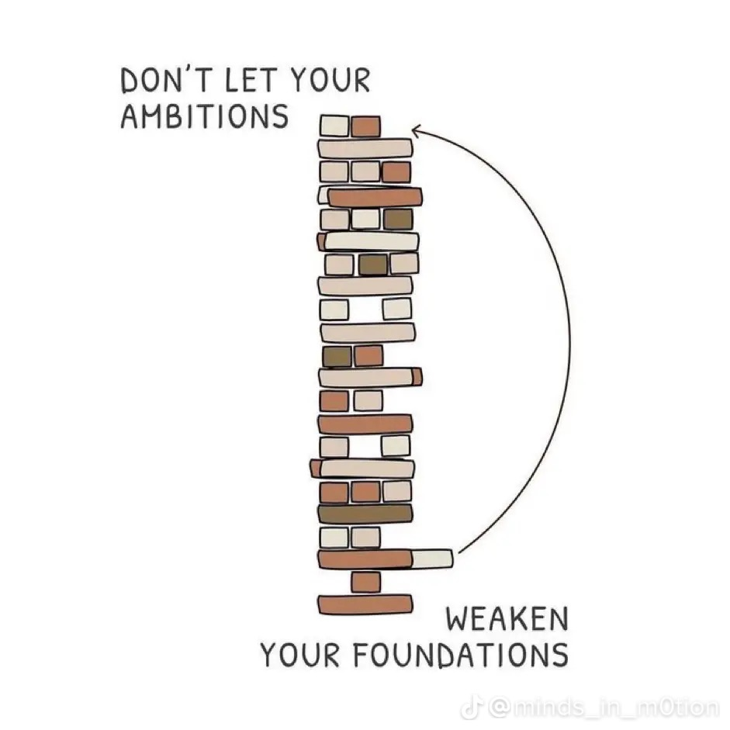
Fundamentals are the doorway to mastery.

